Slide 1
React exercise
Calculator

Slide 2
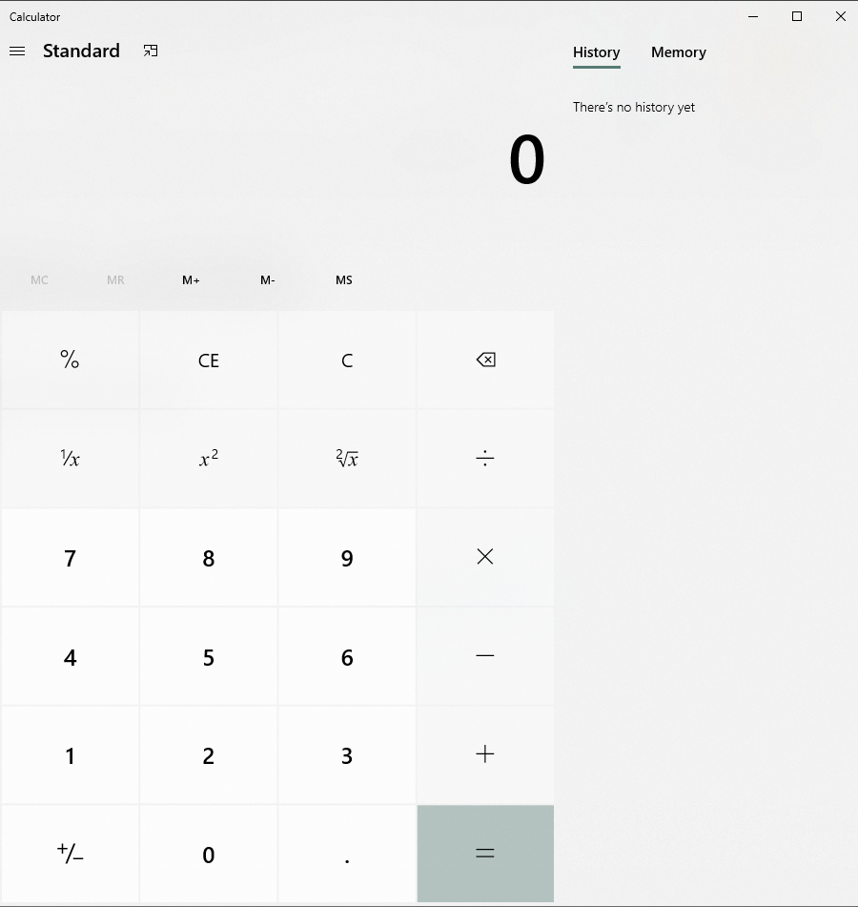

Slide 3
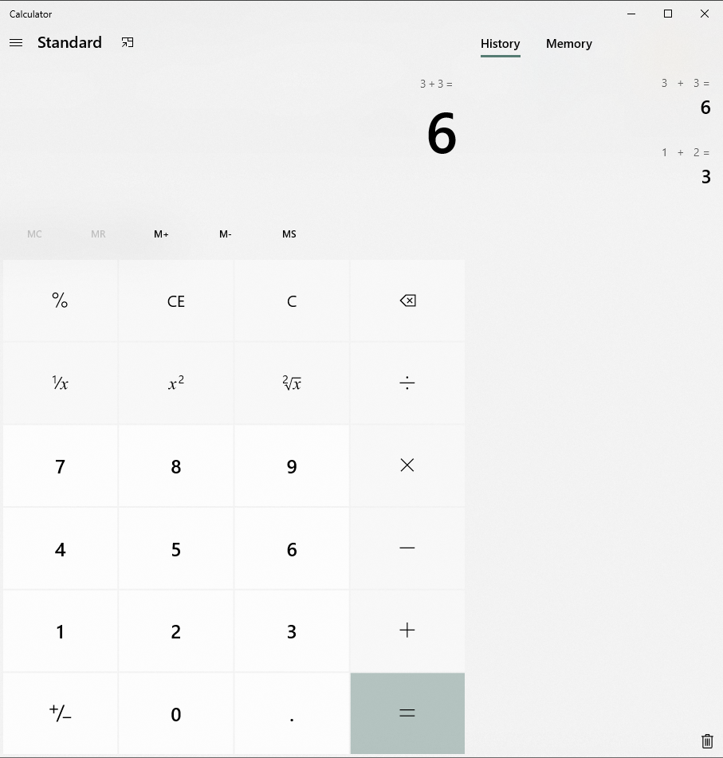
General layout
Main container
Last operation
Result
Buttons container
Sub-sections

Slide 4
Result view
Requirements:
When any number button is clicked, we should display the aggregated number here. Ex. If user clicks 6, we should show 6, if user press 3 after that we should show 63.
When user presses equal button (=) the operation should be made and displayed in the result view.

Slide 5
Last operation
Requirements:
Each time a user clicks an operand (+, -, x or ÷) the current number on the result view should be taken and displayed here together with the operand symbol. Example: if 3 is on the result view and user presses operand + we should display `3 +` here.
If user press the equal button, we should display the full operation here. Example `3 + 2 =`

Slide 6
History
Requirements:
Each time a user clicks on the equal button (=) we should display the full operation here together with the result. Example `3 + 3 = 6`.
Operations here must be displayed following a LIFO order. Example: last operation must be at the top.
If there’s no history this window must display the text: “There’s no history yet”
Add a delete history icon. This icon will delete all history.

Slide 7


Buttons container
Requirements:
The button container will contain all the buttons required for the calculator to work
The buttons marked in red are not necessary
The buttons marked in green will do nothing (are just there for layout alignment)
CE will replace current value in the result view with 0.
C button will erase value from last operation and result view.
If user press backspace (←) we should remove last number entered. If there’s only one number left, then we should display 0. Example: if we have 63 displayed and user presses backspace we should show 6. If user press backspace again we should display 0.
If equal button (=) is clicked, we should perform the operation, display the result of the operation in the result view and update the last operation view with the full operation, example: `3 + 3 =`

